Slide 1



Slide 2

First of all, thank you for volunteering for Run Garioch. Our event could not go ahead without you all, so we really do appreciate all of your help and support.
Prepare as much as possible and familiarise yourself with the marshal duties, instructions and route maps.

Slide 3
Registration
This will take place from 07:30 with a briefing at 0750 in the Main Hall at Garioch Sports Centre on race day, Sunday 10th May 2026.
After initial check-in at the hall, you will receive a printed version of your marshal point brief. Members of the Race committee will be on hand to answer queries and ensure the following:
Provision of Hi Viz vest
Provision of breakfast (at registration) and lunch pack
Details of telephone numbers for key contacts.

Slide 4

Transportation
Transportation by Mini-Bus will be provided by GSC to certain Marshal Points in time for race start and collection made after the last runners have cleared the various marshal points and roads re-opened.
All other Marshal Points to be accessed on foot – Marshals should ensure they allow sufficient time to reach their location.
Marshals 2-13 inclusive – Depart no later than 08:30
Marshals 14, 15 & 16 – Depart no later than 09:30
Transportation for Marshals at Points 17 to 24 inclusive, will meet with drivers in the Registration hall at 08:45 where they will travel on foot to the buses which will leave at 09:00 sharp (so they can be away before the 5k race starts).

Slide 5
Marshal Duties
Please familiarize yourself with the separate ‘Marshal Duties’ document as this will provide detailed information on your specific marshal point.
Ensure you wear your Marshal Hi Viz vest at all times.
Work with the Traffic Management (Alba). Ensure all road closures remain in place until instructed by Race Control/Alba that they can be re-opened.
Direct and help runners along the route. If any athletes retire from the race, take their details and pass these on to Race Control/Committee member as soon as possible.

Slide 6

Marshal Duties
If any runners require medical assistance, please call the Race Hub as asoon as possible who will get help directly (ambulance if needed) to you.
Return Hi Viz Vest to Registration Team at the Garioch Sports Centre after the completion of duties. Please also take the marshal point signage (in the ground) back with you if possible
In the event of any altercation with a 3rd party, where possible take a note of any car registration and report details to the Assistant Race Director/Race Committee member.
Please dress appropriately and for all conditions as the weather can change suddenly… we are in the North East of Scotland after all!

Slide 7

Marshal Duties
But most importantly, ENJOY the experience and give the runners the loudest SHOUTS and CHEERS of encouragement that you can!

Slide 8
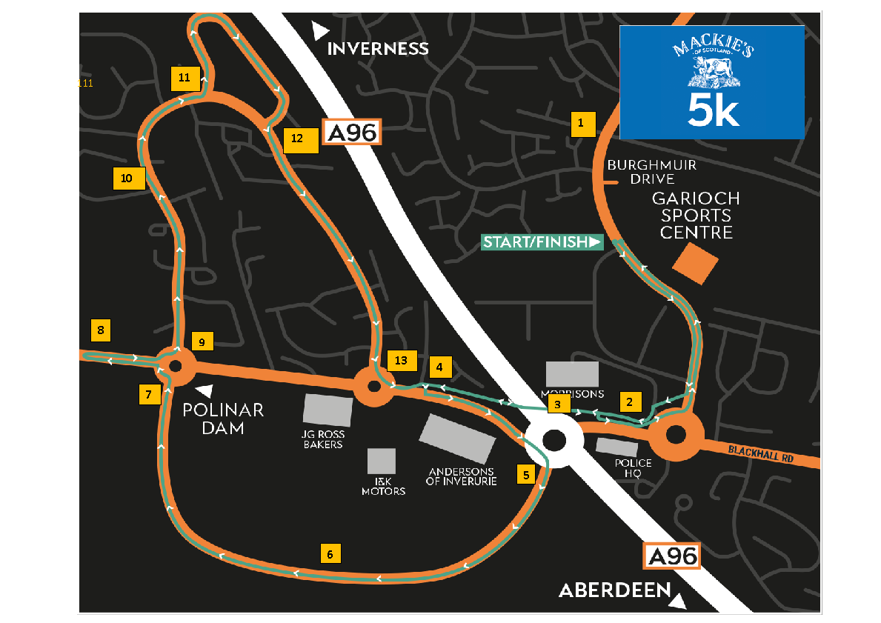
Mackie’s 5k route

Slide 9
Mackie’s 5k route
5k race starts at 9:15am.
About 400 runners
Marshal numbers 1 – 13.
All marshals for the 5k will walk to their allocated area.
We would advise leaving GSC no later than 8.30am to be in position for 9am.
Notes:
Position 2 (Morrisons) – ensure pedestrians cut through Morrison’s car park to avoid the route.

Slide 10
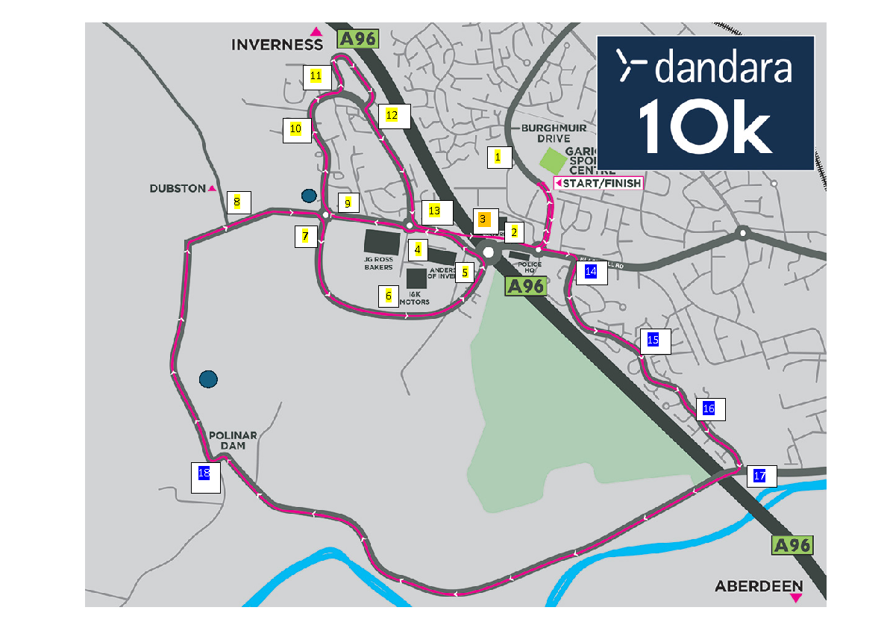

Cala 10k route

Slide 11
Cala 10k route
10k race starts at 10:30am.
About 600 runners
Marshal numbers 1-18. Marshals 1-13 (same position as they are for the 5k) with 14-18 being for the 10k only.
Buses will be provided for marshalls 17 & 18 if required.
We would advise leaving GSC no later than 8.30am to be in position for 9am if walking (for those doing both 5k and 10k points).
If on the bus, we will meet at 8.45am with the bus leaving at 9am.

Slide 12
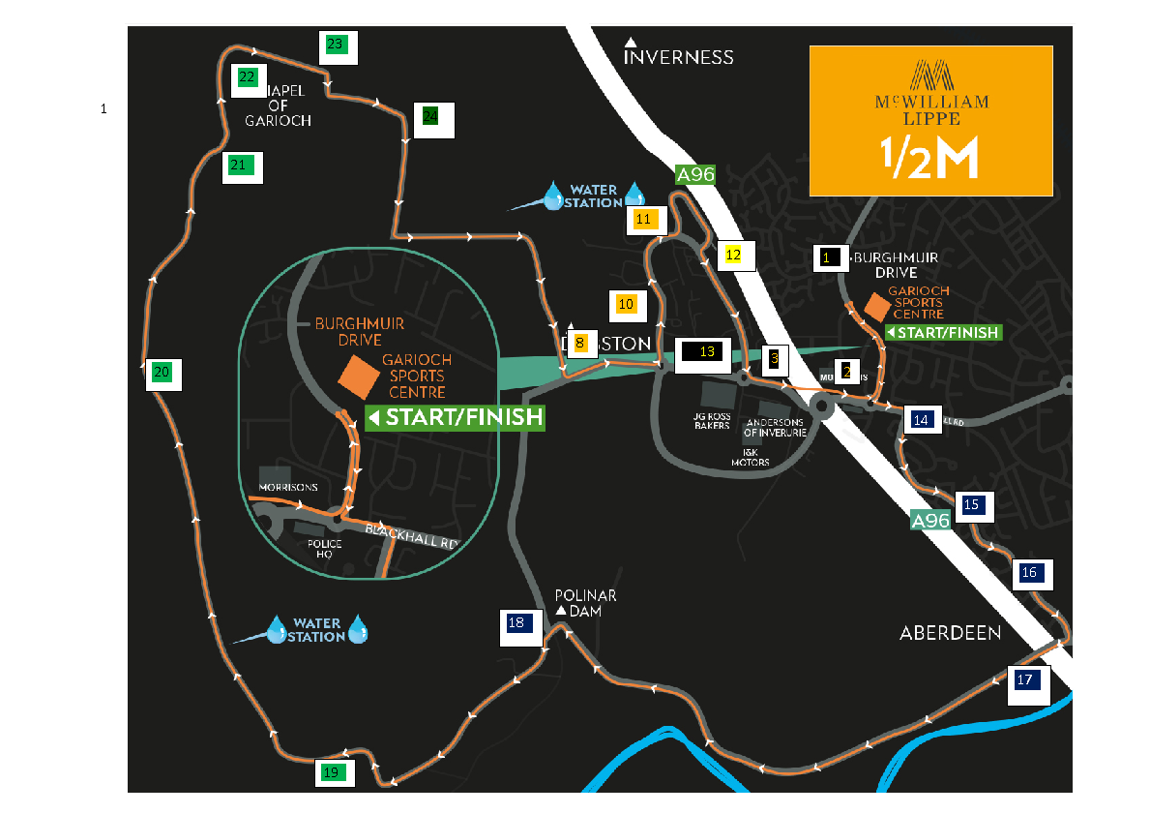
McWilliam Lippe 1/2m route

Slide 13
McWilliam Lippe 1/2m route
1/2 marathon race starts at 10:15am.
About 450 runners.
Marshal numbers primarily 14 – 24 with some cross over with the other races.
Buses will be provided for marshals 17 – 24.
For the bus, we will meet at 8.45am with the bus leaving at 9am.

Slide 14
In conclusion…
Familiarise yourself with your allotted marshal point and the routes so you know exactly where to go and when to be there for.
Arrive sharp 7.30am at GSC on Sunday 10th May for registration.
Dress appropriately and be prepared for all weather conditions.
Come with your loudest cheer voice to motivate the runners!
Any questions before Race Day, please email volunteers@rungarioch.co.uk
Thank you again – Run Garioch would not be able to go ahead without our incredible volunteers!

Slide 15
Important information
All route maps and marshal duty documents can be found on the Run Garioch website at the link below:
https://www.rungarioch.co.uk

